Slide 1

Version control with Git
Shuai Wei
IS&T Research Computing Services
Boston University

Slide 2
Git: main features
Track all your changes
Work along with others
Share work with others
With Git

Slide 3
Git Workflow
Local
computer
Github.com

Slide 4
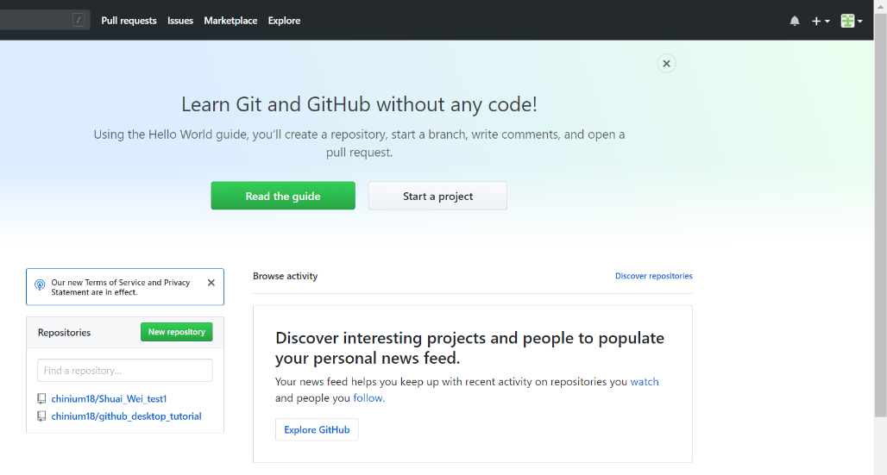
Github.com
A web-server that allows you to save/access your repository remotely.
Easy to share with collaborators.

Slide 5
Git Terminology
Repository-container for snapshots and history
Remote-connection to another repository for example GitHub (like URL)
Commit-
A snapshot, basic unit of history
Full copy of a project
Includes author, time, comments, pointer to the parent
Reference-a pointer to commit
Branch -a separate line of workflow
Merge-a commit that combines 2 lines of history (points to 2 parents)

Slide 6
Installing Git

Slide 7
Login to the SCC
Username: tuta#
Password: VizTut#
#-is the number located on your computer
Note:
•Username and password are case-sensitive
•password will not be displayed while you are typing it

Slide 8
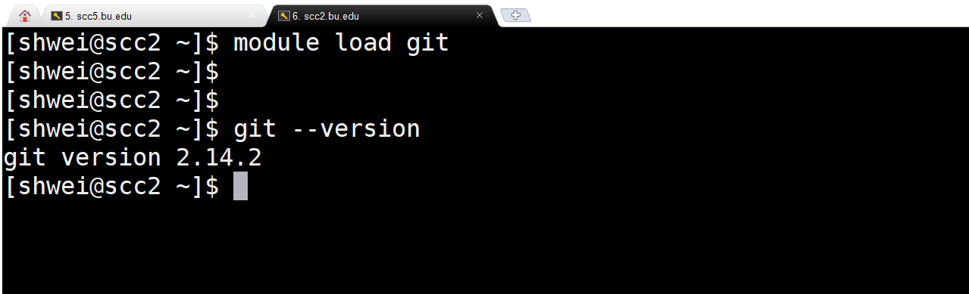
Git: basic configuration
# select the latest version of git
# check gitversion

Slide 9
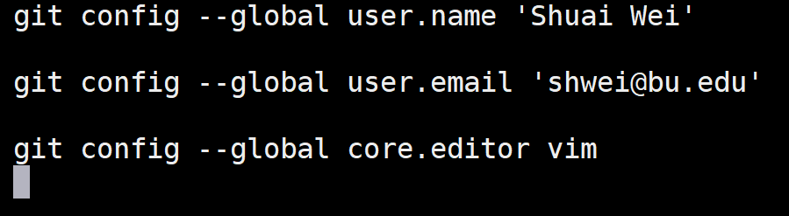
Git basic configuration
Command
Flag
Key
Value
Interpreter
program
Notes:
•Vim is the default editor used by git
•Select gedit if you are not familiar with vim or emacs editors

Slide 10
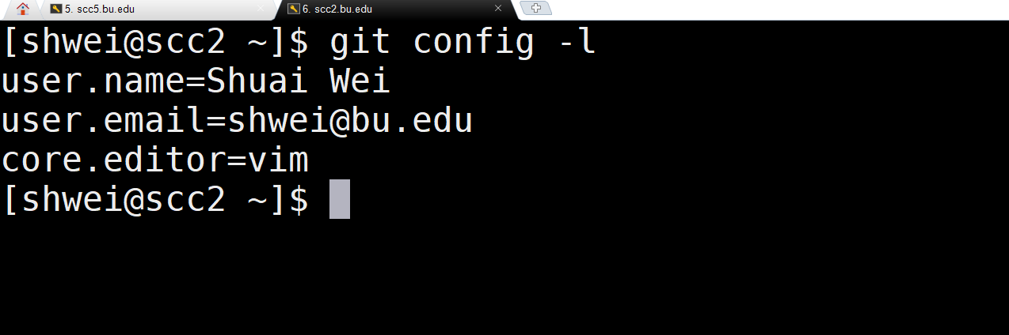
Git basic configuration

Slide 11
Git advanced configuration

Slide 12
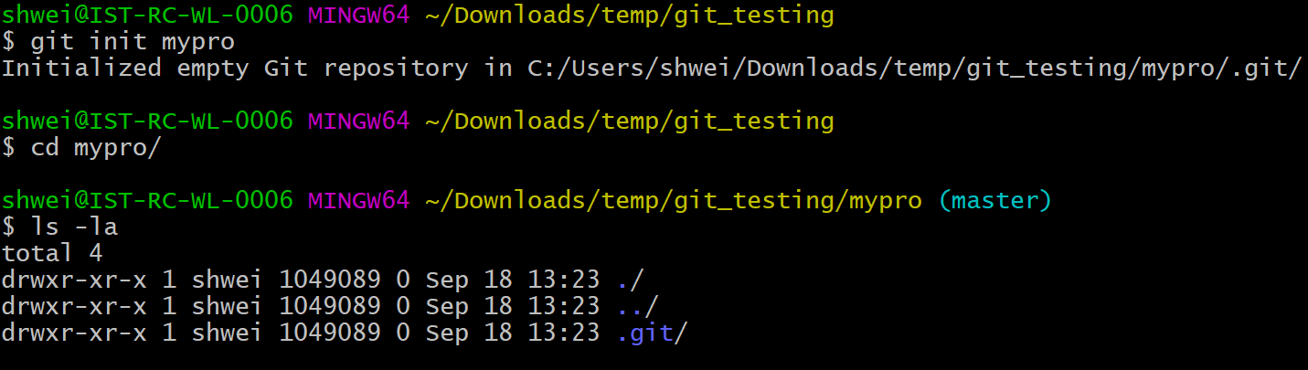
Git create a repository (from nothing)
# create a project with a name mypro
# change directory (go inside project directory)
# list files in the directory

Slide 13
Git status

Slide 14
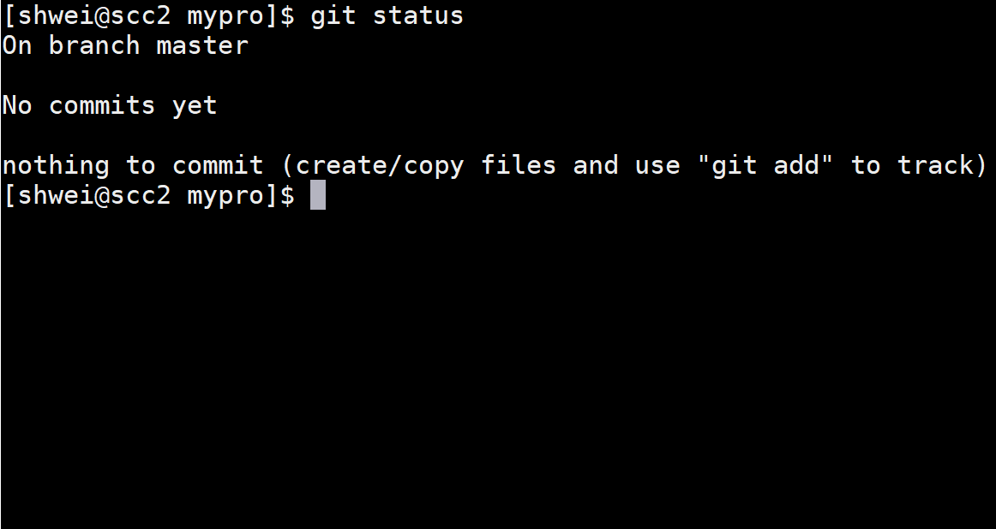
Git check the status

Slide 15
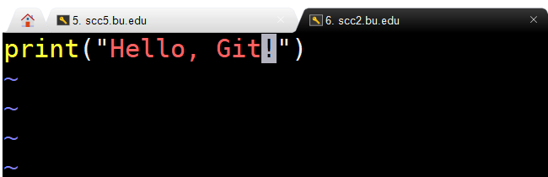
Create a new file
Using your favorite editor, open a file hello.py and enter the following content:
Save the file with the name hello.py and exit.
Note: if you are not familiar with vim or emacs editors, used gedit to edit files:
gedithello.py

Slide 16
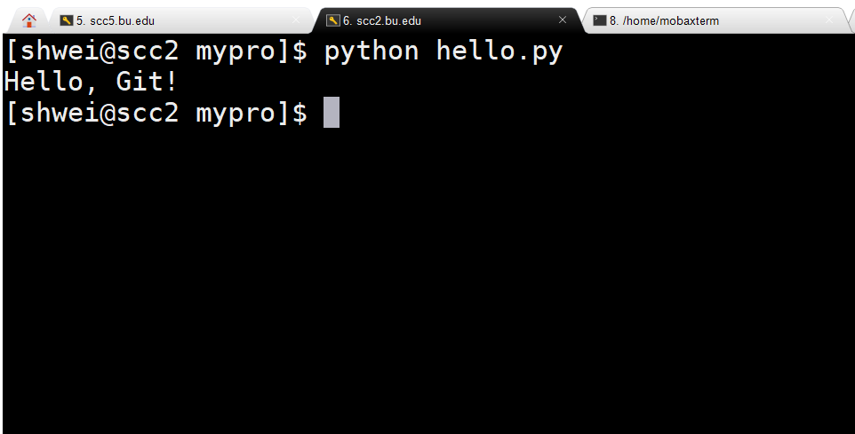
Execute the python script (optional)

Slide 17
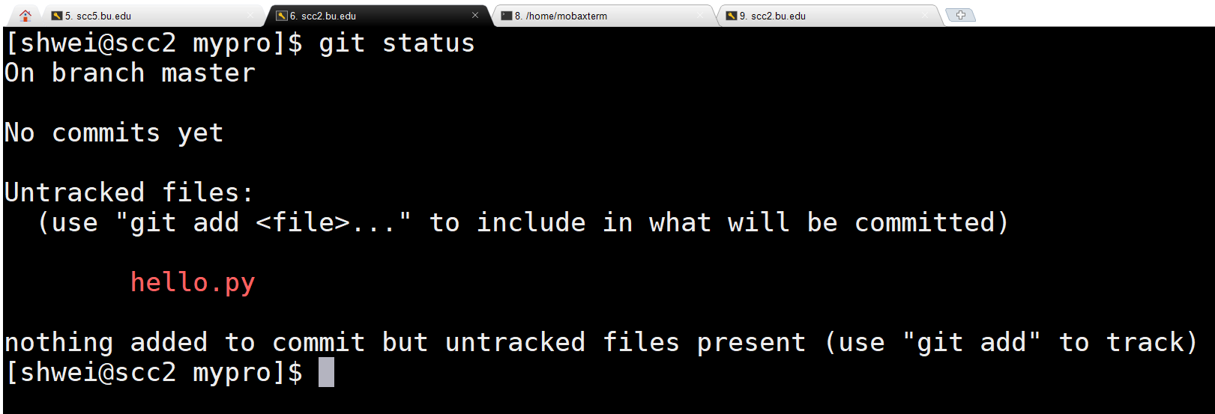
Git check the status again

Slide 18
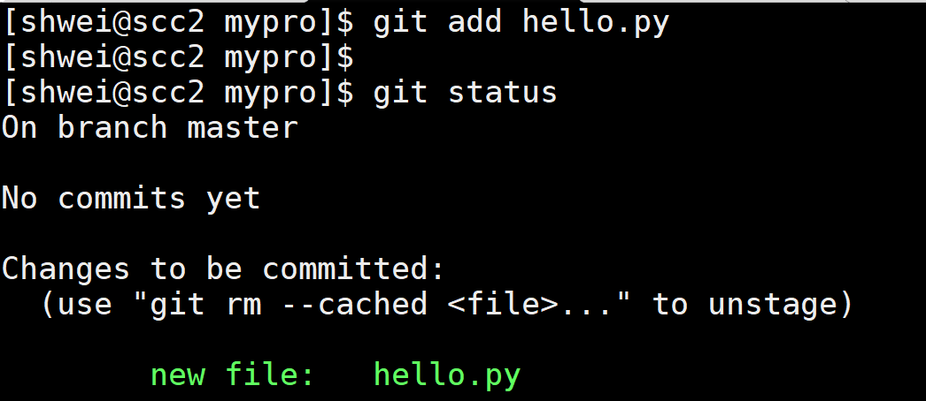
Git add the file to the repository

Slide 19
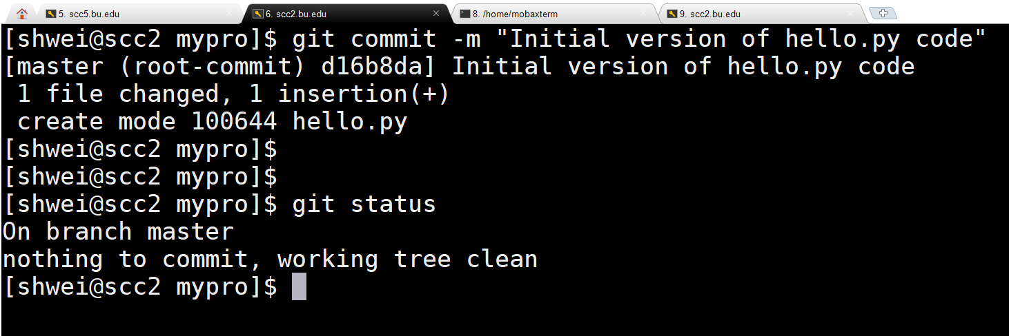
Git commit
Note: Make sure to enter clear, concise and meaningful comments about your commits!

Slide 20
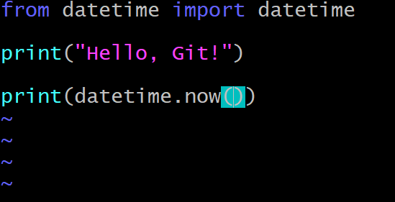
Modify a file that is tracked by git
Use your favorite editor to edit hello.py file.
Save and exit it.

Slide 21
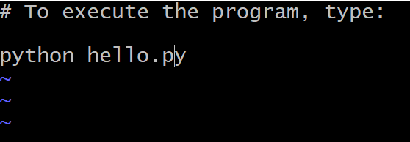
Create a new README file
Create and edit your file of name README.
Save and exit it.

Slide 22
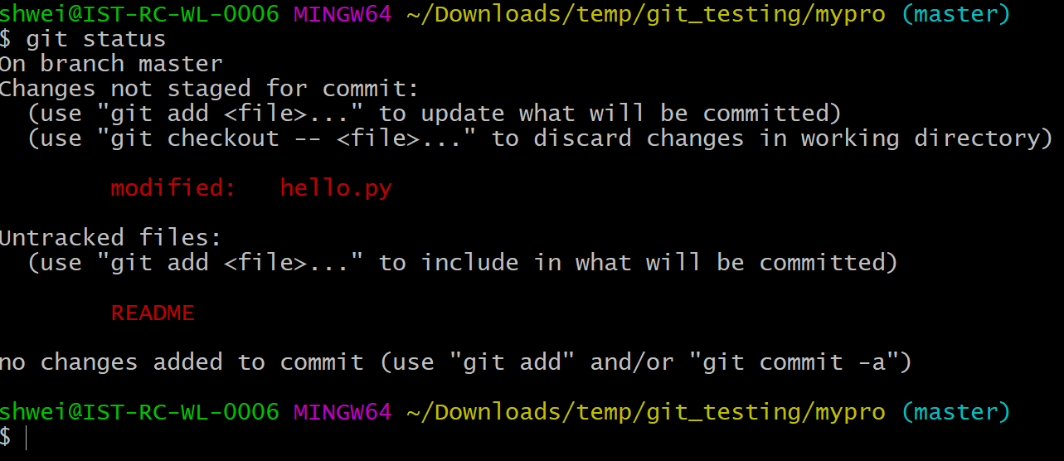
Check the status

Slide 23
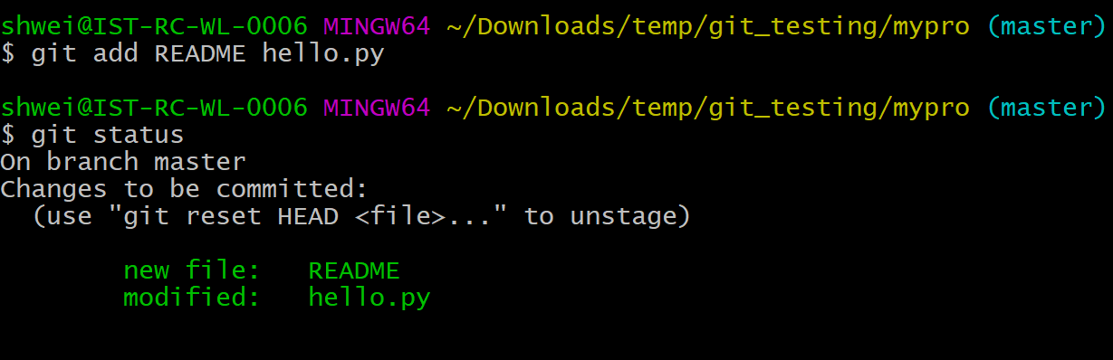
Add both files on staging area
Note: Files can be added one by one or listed together

Slide 24
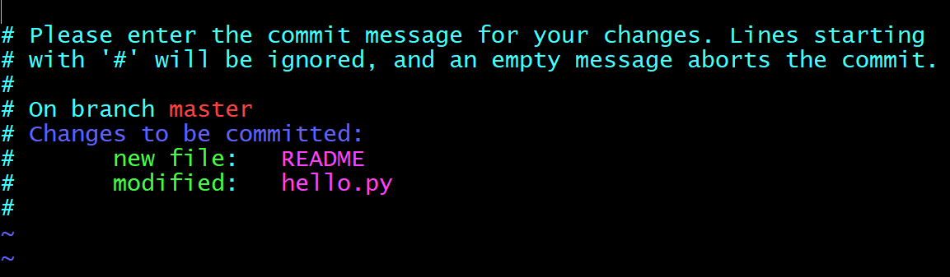
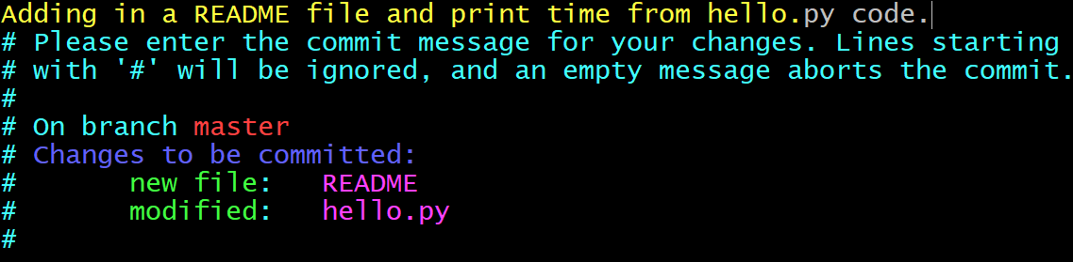
Git commit
Write your commit message here and save/exit this file
Save and exit it.

Slide 25
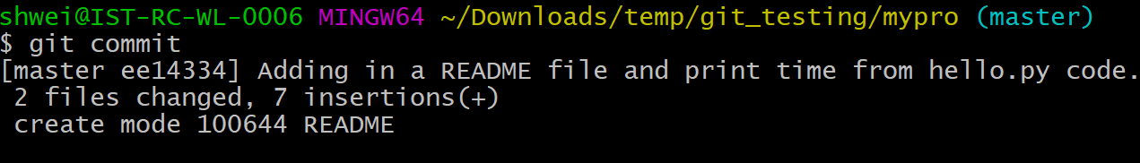
Git commit

Slide 26
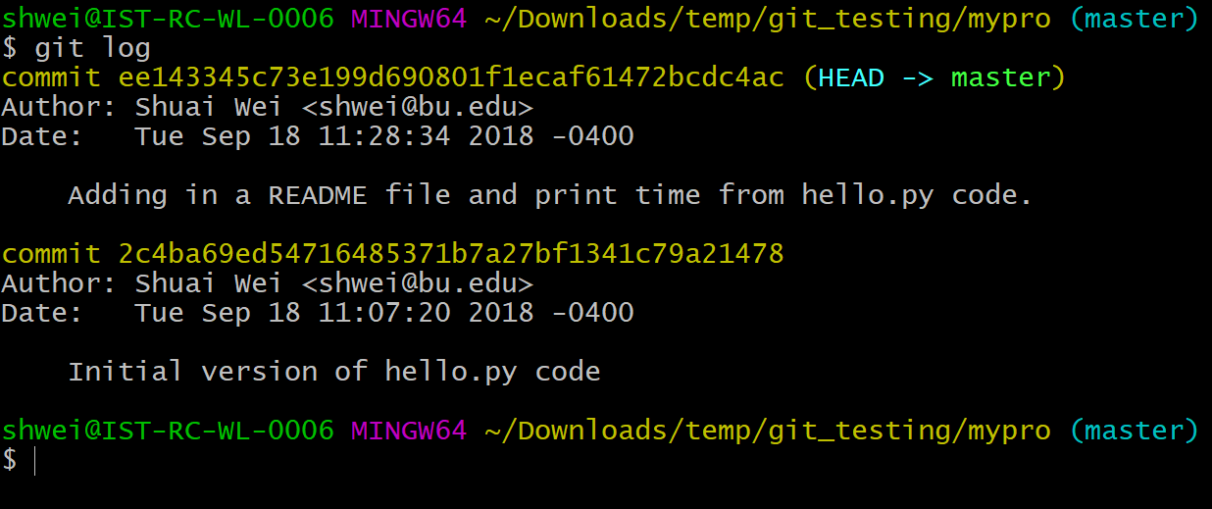
Git: view the history of commits

Slide 27
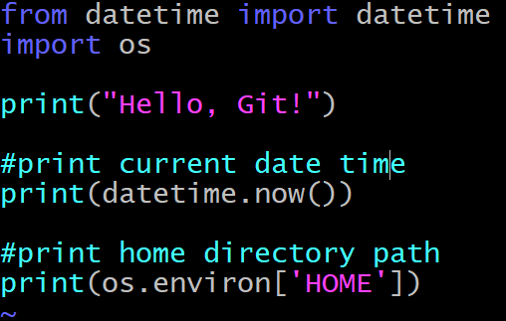
Modify a hello.py file again
Edit your hello.py file like this:
Save and exit it.

Slide 28
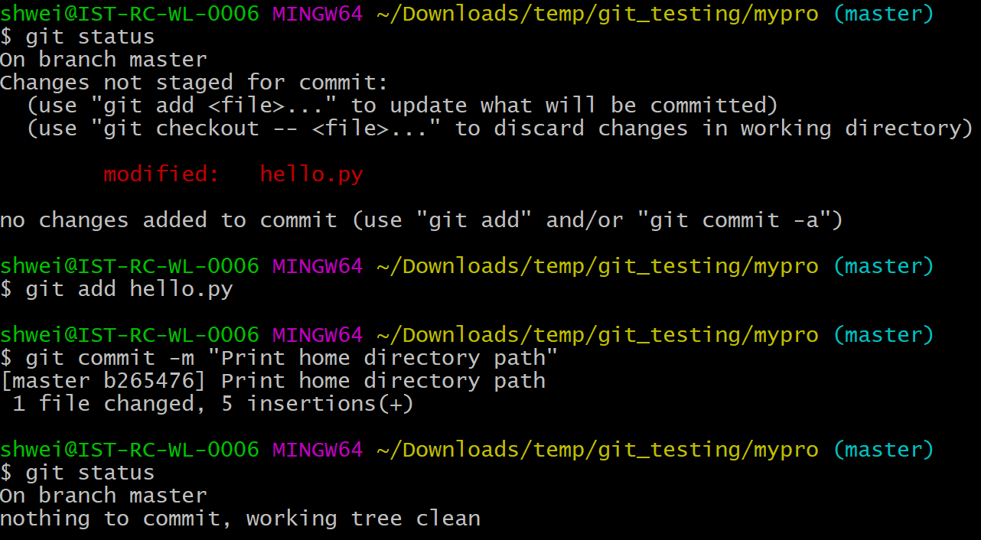
A full checking/adding/committing process

Slide 29
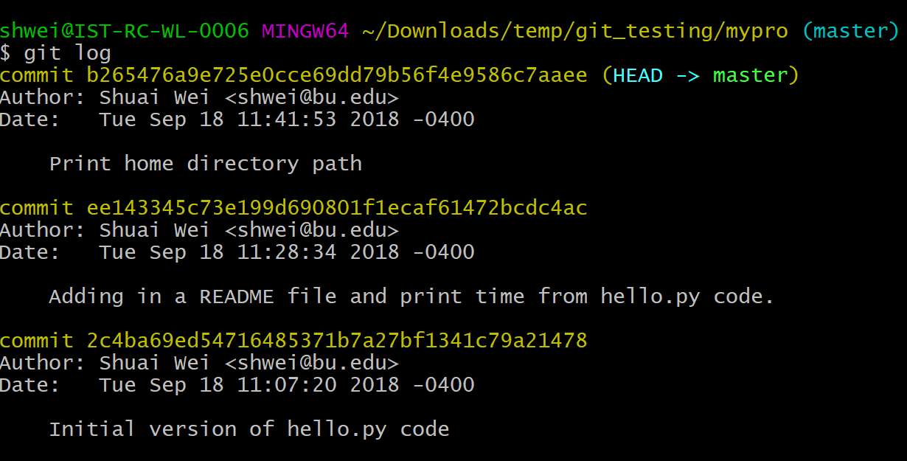
Git: view log with a graph

Slide 30
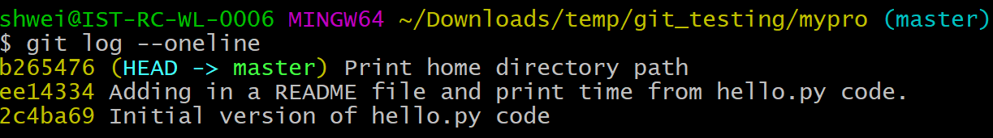
Git: one line log

Slide 31
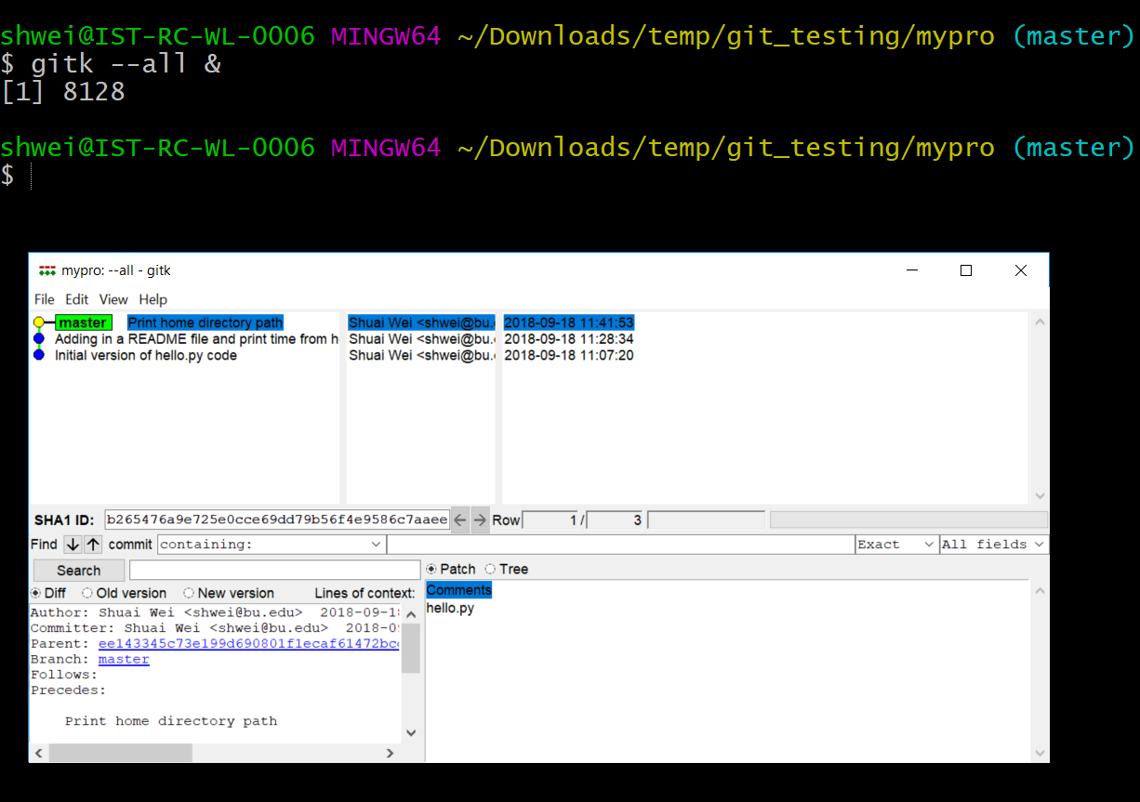
Git: graphical tool

Slide 32
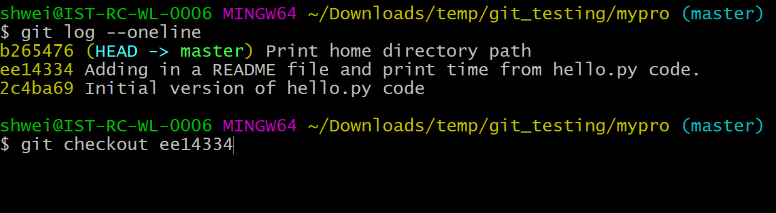
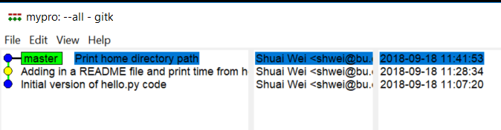
Git: reviewing previous commits

Slide 33
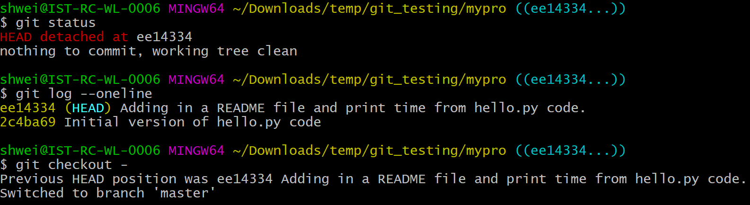
Git: returning to the last commit

Slide 34
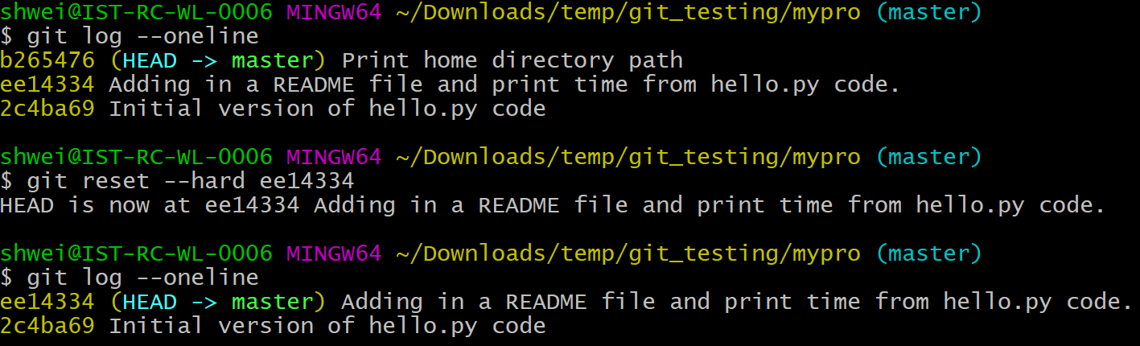
Git: hard delete of the latest commits

Slide 35
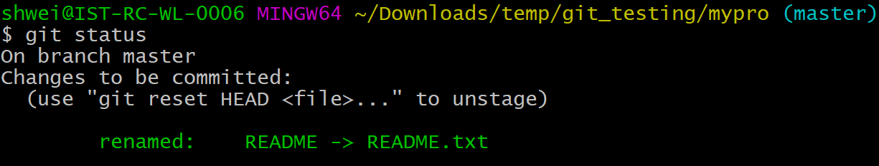
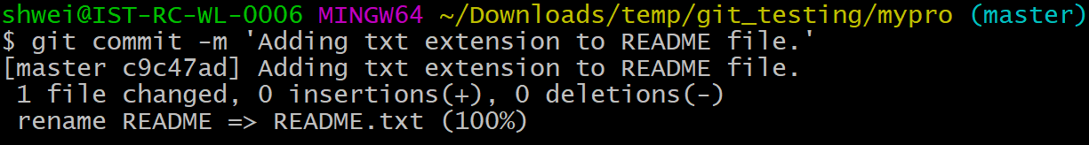
Renaming a file (Git way)

Slide 36
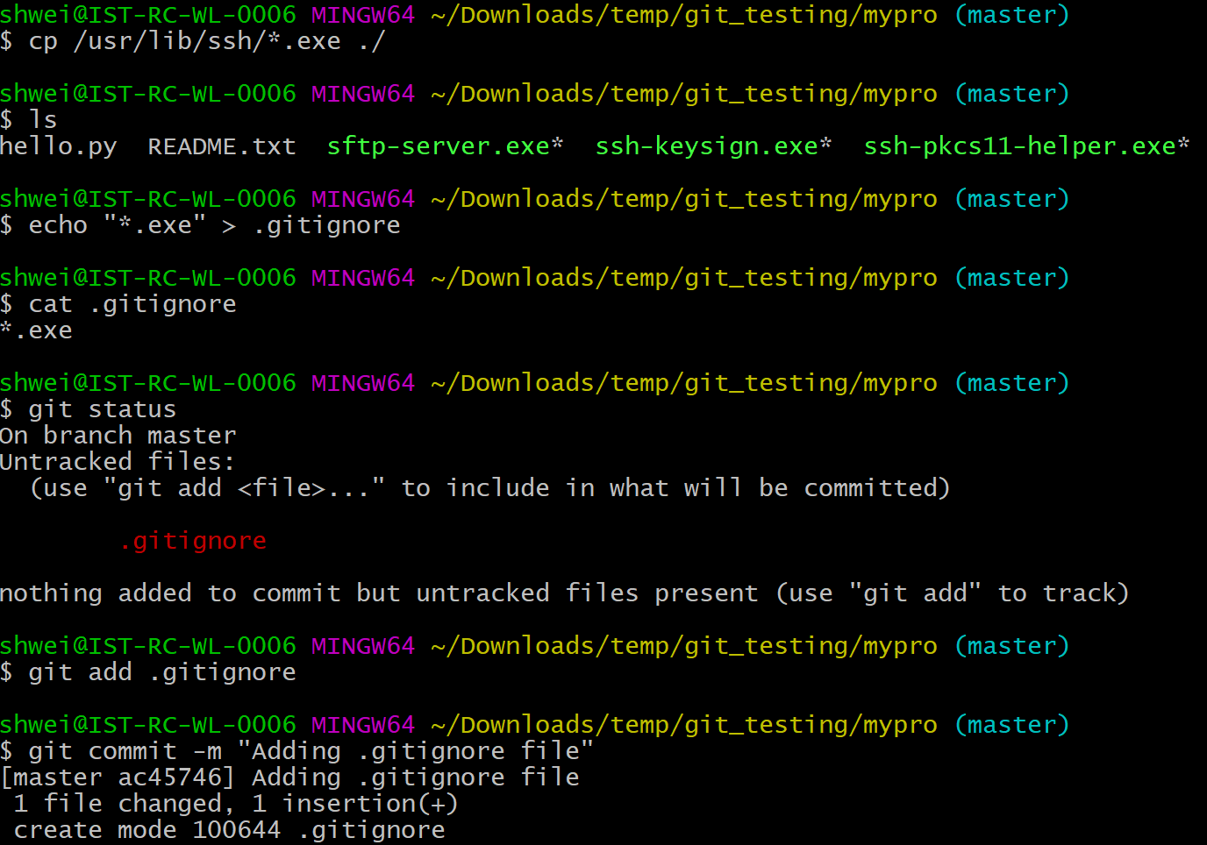
Git ingore

Slide 37
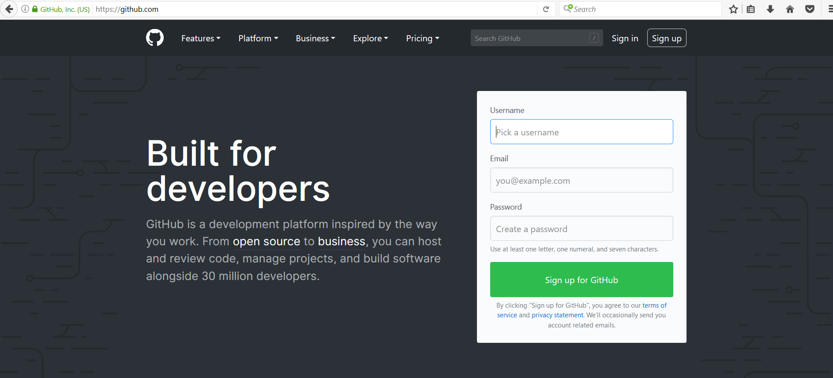
Github.com
A web-server that allows you to save/access your repository remotely.
Easy to share with collaborators.

Slide 38
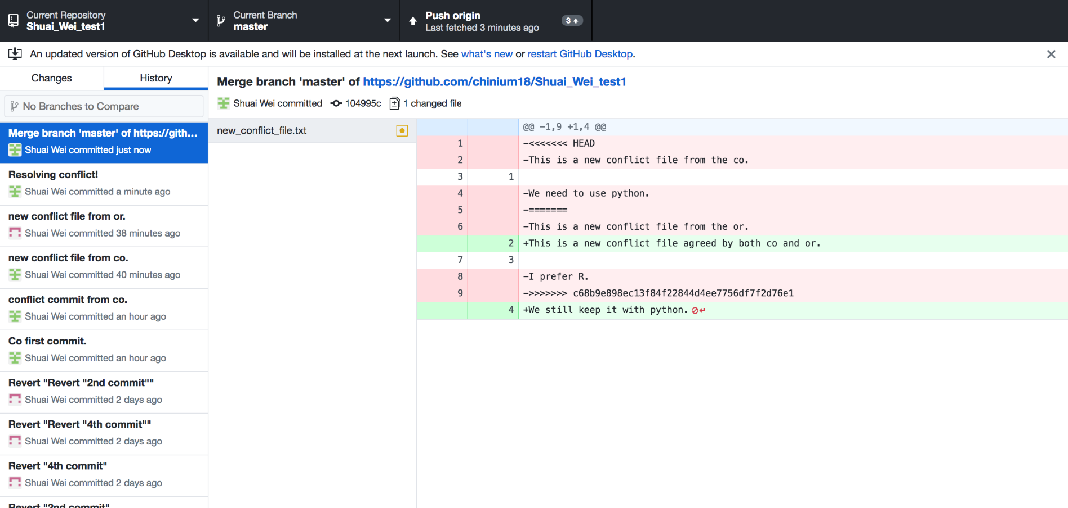
GitHub desktop
It’s a fast, easy way to contribute to projects from OS X and Windows.
GitHub workflow and replace GitHub for Mac and Windows with a unified experience across both platforms.

Slide 39
Setting up GitHub Desktop
Installing GitHub Desktop
https://desktop.github.com/
Authenticating to GitHub
Add your GitHub.com account information to GitHub Desktop
Configuring Git for GitHub Desktop
If you don’t have Git installed, you must configure it before using GitHub Desktop.

Slide 40
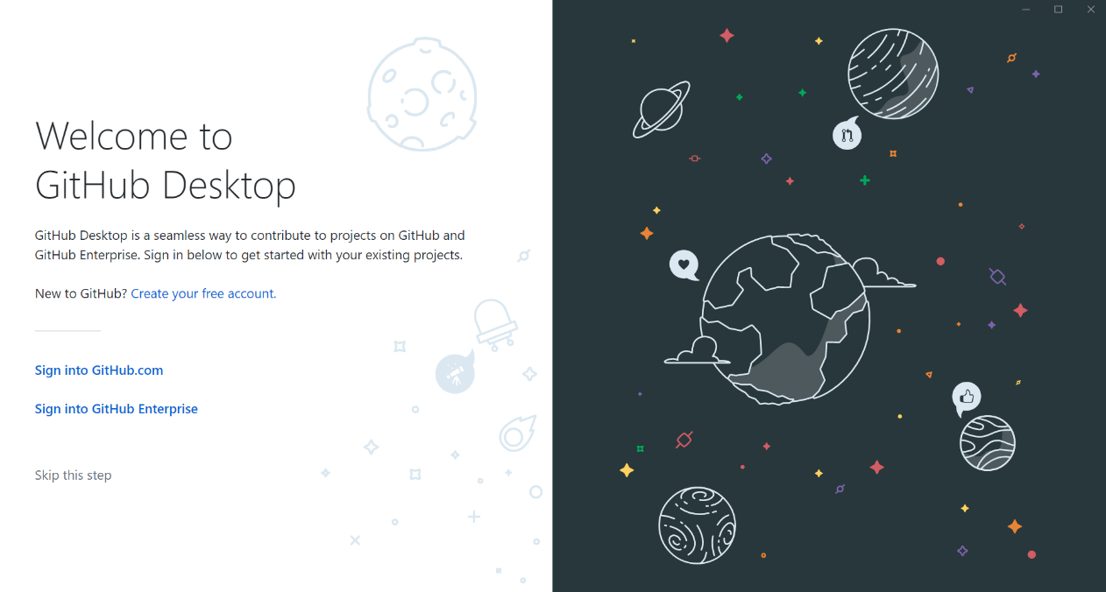
Authenticating to GitHub
or

Slide 41
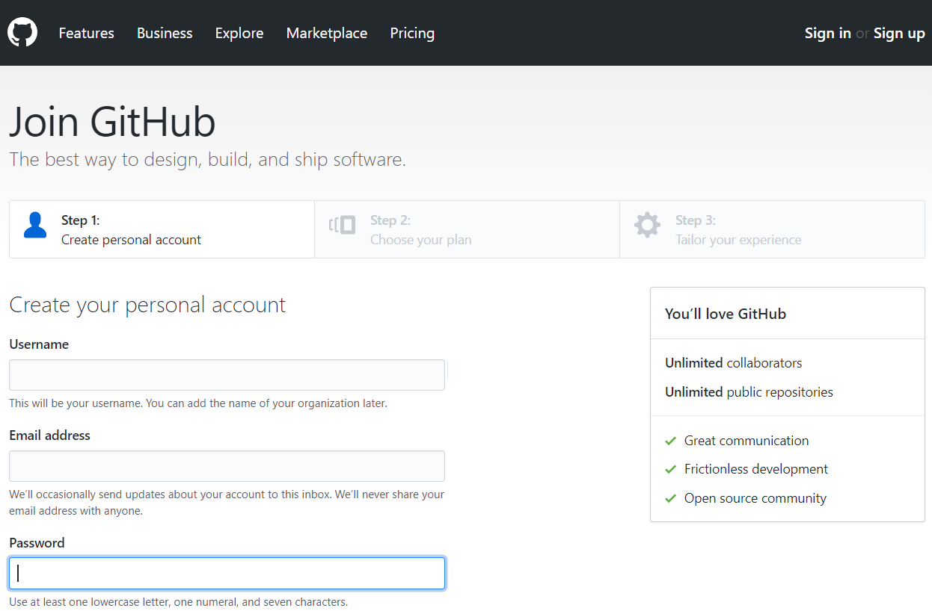
Creating GitHub account if you don’t have an account already

Slide 42
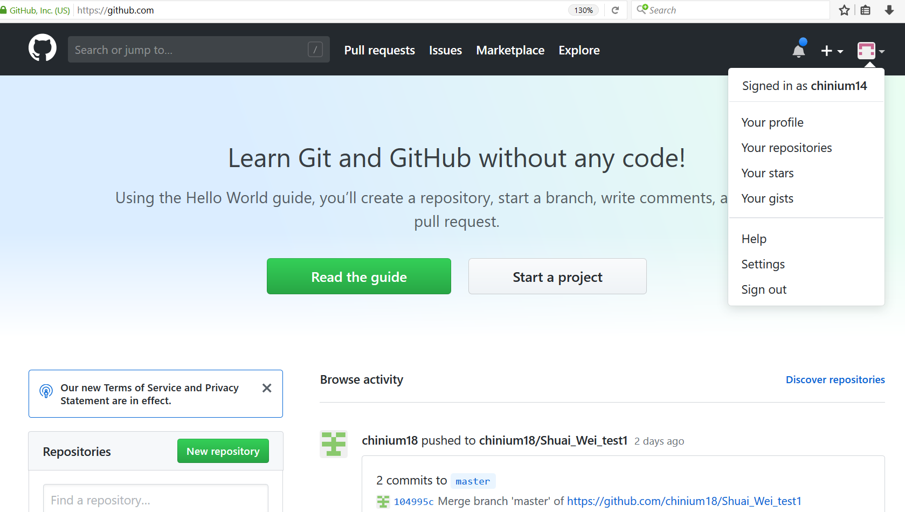
Configuring GitHub account

Slide 43
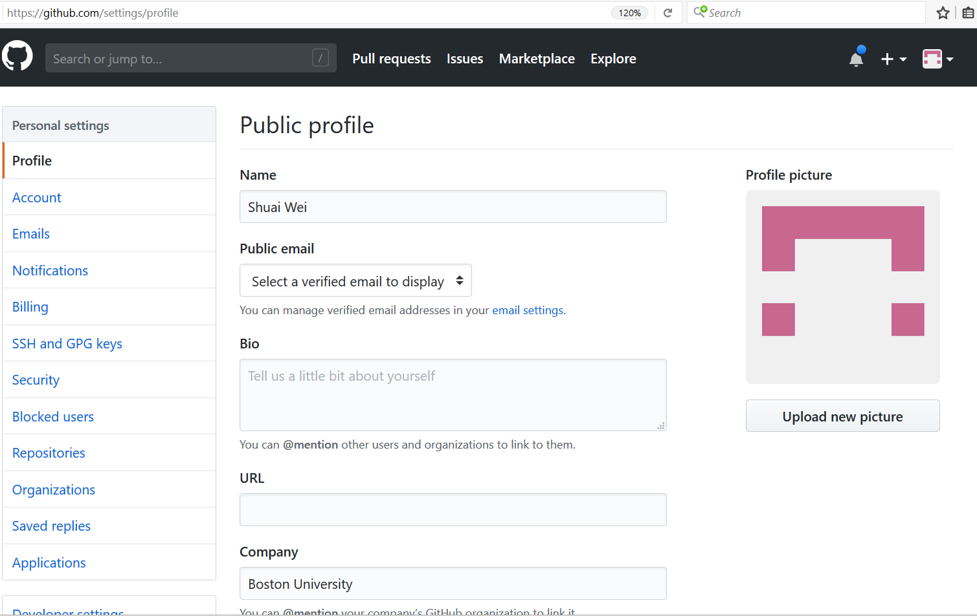
Configuring GitHub account

Slide 44
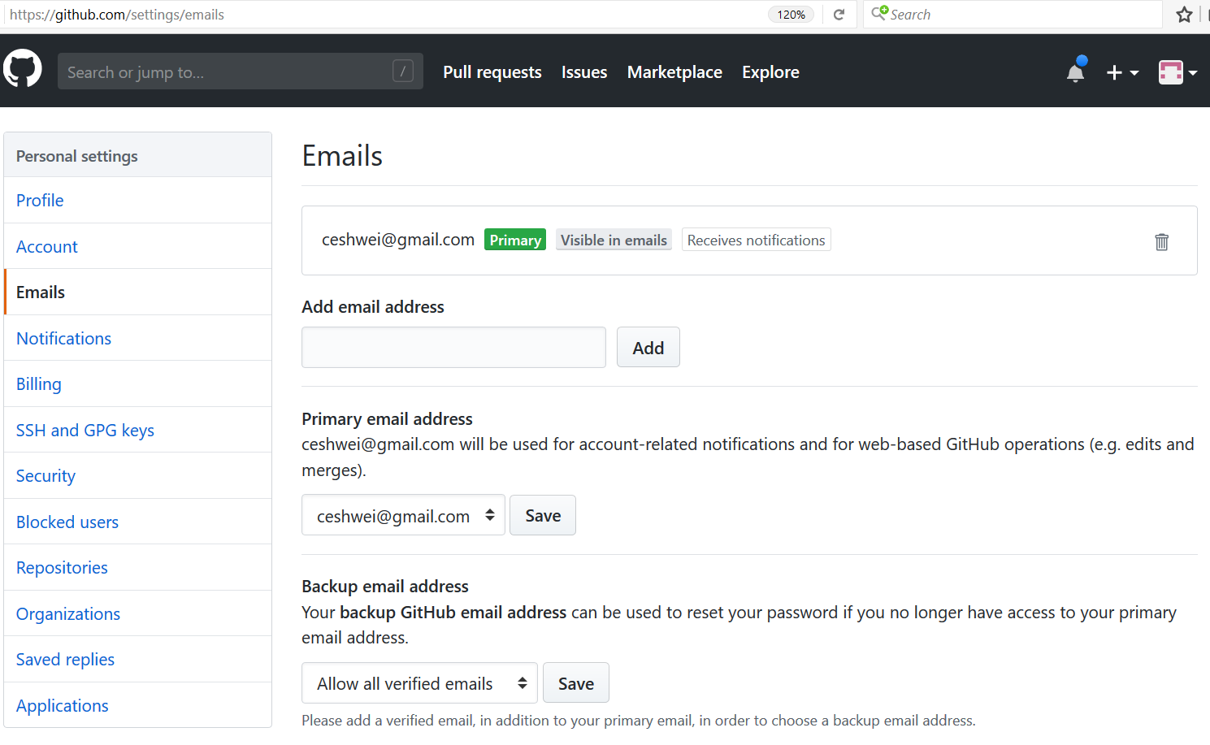
Configuring GitHub account

Slide 45
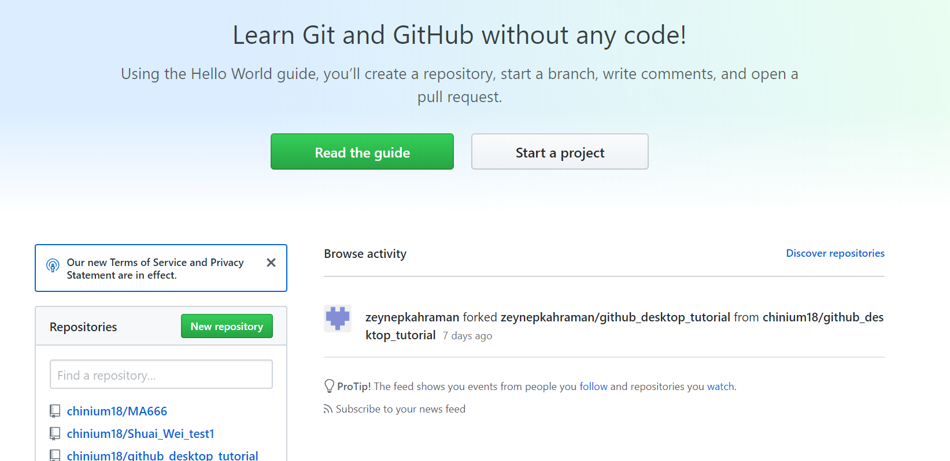
New repository

Slide 46
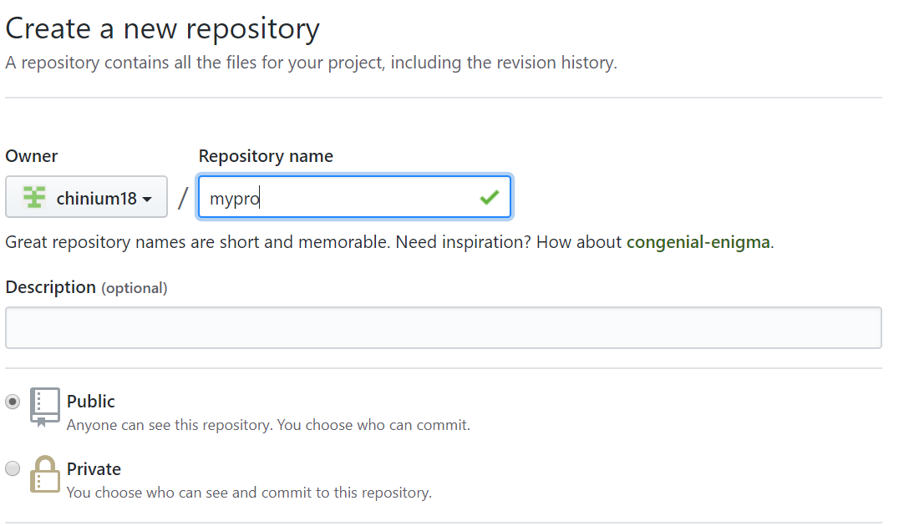
New repository

Slide 47
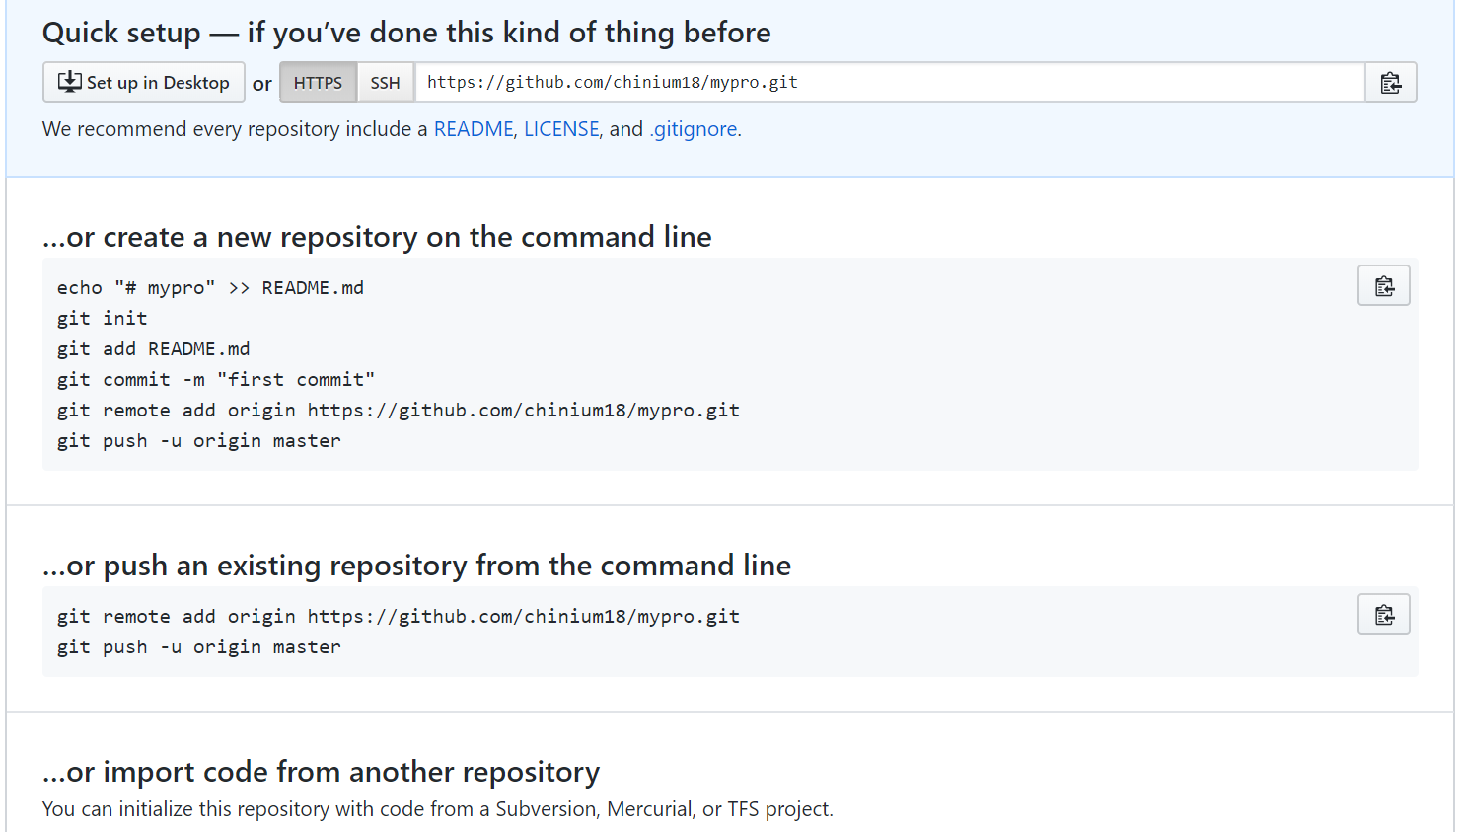
Since we have an existing repository on local:

Slide 48
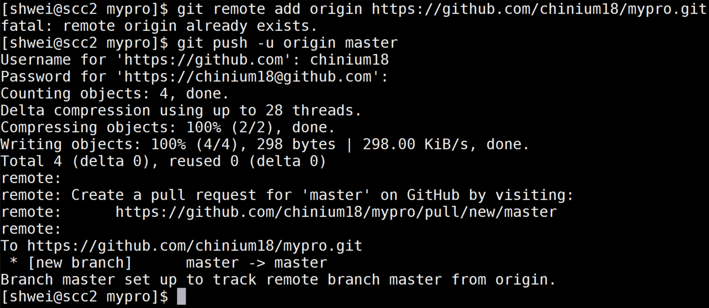
Push the local repository to Github.com

Slide 49
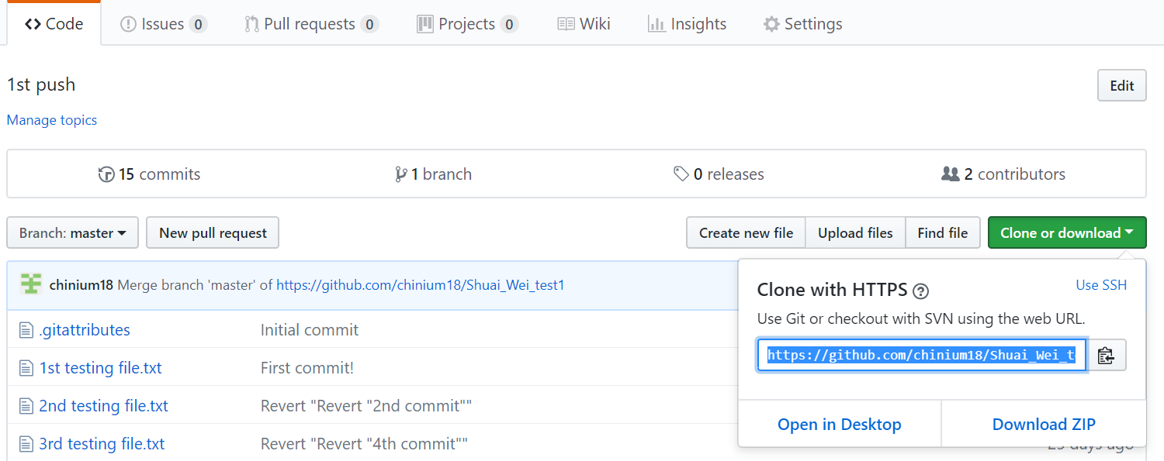
Download/ Git clone

Slide 50
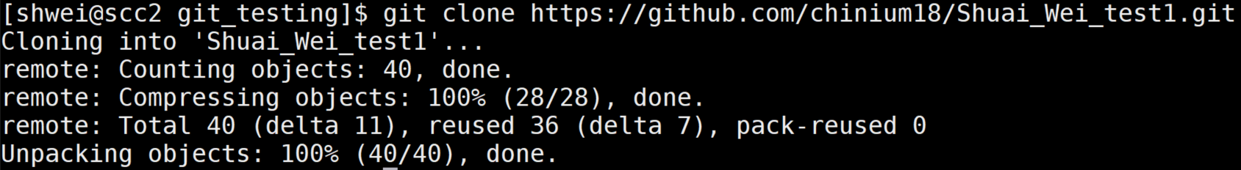
Git clone <remote_address>

Slide 51
Other resources to learn Git:
https://help.github.com/desktop/
http://try.github.io/
https://www.atlassian.com/git/tutorials
git help

Slide 52
Thank you for attending the tutorial!
Please fill the evaluation form:
http://scv.bu.edu/survey/tutorial_evaluation.html
Questions:
help@scc.bu.edu

